Slide 1
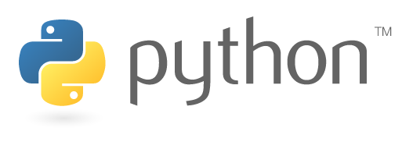
UNIT-1
Python Programming

Slide 2
Topics covered
Data types in Python:
Comments in Python
Docstrings
identifiers and reserved words
naming conventions in python.
constants in python
Built-in datatypes: None, Numeric and bool Data type
Sequences in python: str, bytes, byte array
data types: list, tuple, dictionaries,set , frozenset
user-defined datatypes

Slide 3
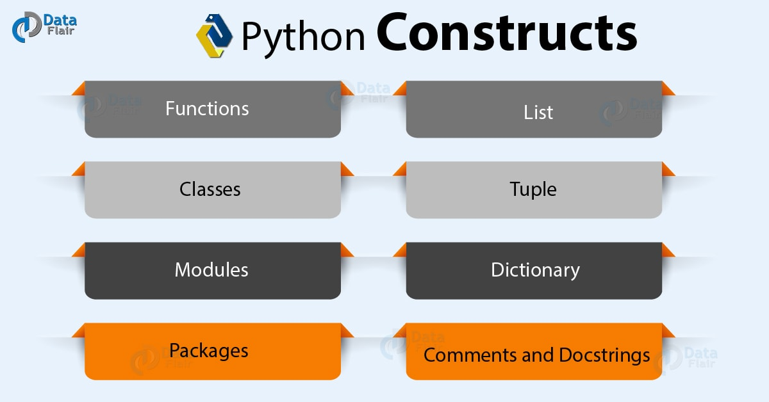
Topics covered

Slide 4
Comments and Docstrings
Comments and Docstrings
Declare comments using an octothorpe (#).
comments are ignored by the compiler during the execution of the program.
However, Python does not support multiline comments.
#This is a comment
# sample comment
name ="Welcome"
print(name)
docstrings are documentation strings that help explain the code. It uses a Delimiter (“””) at each end.
“”” This is a docstring “””

Slide 5
Comments and Docstrings
Comments are generally used for the following purposes:
Code Readability
Explanation of the code or Metadata of the project
Prevent execution of code
To include resources
Types of comments
Single Line Comments: #
Multi-Line Comments: text enclosed in a delimiter (""") on each end of the comment
"""
This would be a multiline comment in Python that
spans several lines and describes comments.
"""
print("Hello")

Slide 6
Comments and Docstrings
In the Python, the docstring is then made available via the __doc__ attribute.
Docstring is an in-built feature of Python, which is used to associate documentation that has been written with Python modules, functions, classes and methods.
It is added right below the functions, modules or classes to describe what they do.
def multiply(a, b):
"""Multiplies the value of a and b"""
return a*b
# Print the docstring of multiply function
print(multiply.__doc__)
Output:
Multiplies the value of a and b

Slide 7
Comments and Docstrings
Declaring Docstrings:
The docstrings are declared using
”’triple single quotes”’ or
“””triple double quotes””” just below the class, method or function declaration.

Slide 8
variable assignment
variables in Python are defined with the assignment operator, the equals sign =.
To define a variable in Python, the variable name is written first, then the assignment operator = followed by a value or expression.
The general syntax to assign a value to variable name is below:
variable_name = value
Variable names in Python must adhere to the following rules:
variable names must start with a letter
variable names can only contain letters, numbers and the underscore character _
variable names can not contain spaces or punctuation
variable names are not enclosed in quotes or brackets
Python variables can store different types of data based on a variable's data type.
A variable's data type is created dynamically, without the need to explicitly define a data type when the variable is created.

Slide 9
variable assignment
Rules and Naming Convention for Variables and constants
Constant and variable names should have a combination of letters in lowercase (a to z) or uppercase (A to Z) or digits (0 to 9) or an underscore (_).
For example:
snake_case
MACRO_CASE
camelCase
CapWords
Create a name that makes sense.
For example, vowel makes more sense than v.
If you want to create a variable name having two words, use underscore to separate them. For example:
my_name
current_salary
Use capital letters possible to declare a constant.
For example:
PI
SPEED_OF_LIGHT
Never use special symbols like !, @, #, $, %, etc.
Don't start a variable name with a digit.

Slide 10
variable assignment
Variables are nothing but reserved memory locations to store values. It means that when you create a variable, you reserve some space in the memory.
Based on the data type of a variable, the interpreter allocates memory and decides what can be stored in the reserved memory.
Therefore, by assigning different data types to the variables, you can store integers, decimals or characters in these variables.
Assigning Values to Variables
Python variables do not need explicit declaration to reserve memory space. The declaration happens automatically when you assign a value to a variable. The equal sign (=) is used to assign values to variables.
For example-
counter = 100 # An integer assignment
miles = 1000.0 # A floating point
name = "John" # A string

Slide 11
Multiple assignment
Python allows you to assign a single value to several variables simultaneously.
For example
a= b = c = 1
Here, an integer object is created with the value 1, and all the three variables are assigned to the same memory location.
a, b, c = 1, 2, "john“
Here, two integer objects with values 1 and 2 are assigned to the variables a and b respectively, and one string object with the value "john" is assigned to the variable c.

Slide 12
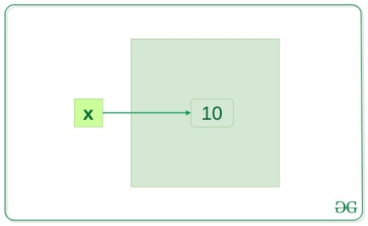
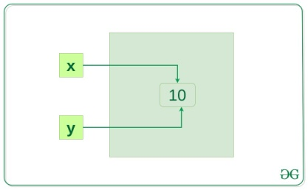
Memory reference
x = 10
y = x
if id(x) == id(y):
print("x and y refer to the same object")
output
x and y refer to the same object
When x = 10 is executed an integer object 10 is created in memory and its reference is assigned to variable x, this is because everything is object in Python.
In the above example, y = x will create another reference variable y which will refer to the same object because Python optimizes memory utilization by allocation the same object reference to a new variable if the object already exists with the same value

Slide 13
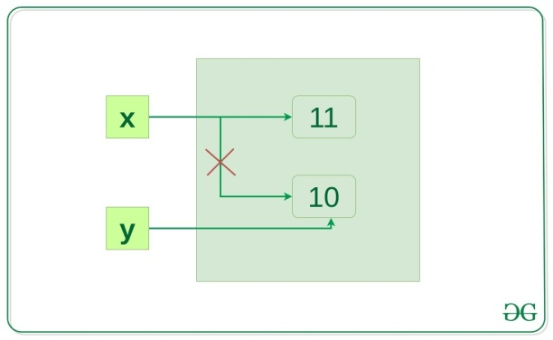
Memory reference
Now, let’s change the value of x and see what happens. x = 10
y = x
x += 1
if id(x) != id(y):
print("x and y do not refer to the same object")
Output:
x and y do not refer to the same object
now x refer to a new object x and the link between x and 10 disconnected but y still refer to 10.

Slide 14
Identifiers
A Python identifier is a name used to identify a variable, function, class, module or other object.
An identifier starts with a letter A to Z or a to z or an underscore (_) followed by zero or more letters, underscores and digits (0 to 9).
Python does not allow punctuation characters such as @, $, and % within identifiers.
Python is a case sensitive programming language
Here are naming conventions for Python identifiers-
Class names start with an uppercase letter. All other identifiers start with a lowercase letter.
Starting an identifier with a single leading underscore indicates that the identifier is private.
_name
Starting an identifier with two leading underscores indicates a strong private identifier.
__name
If the identifier also ends with two trailing underscores, the identifier is a language defined special name.
__name__

Slide 15
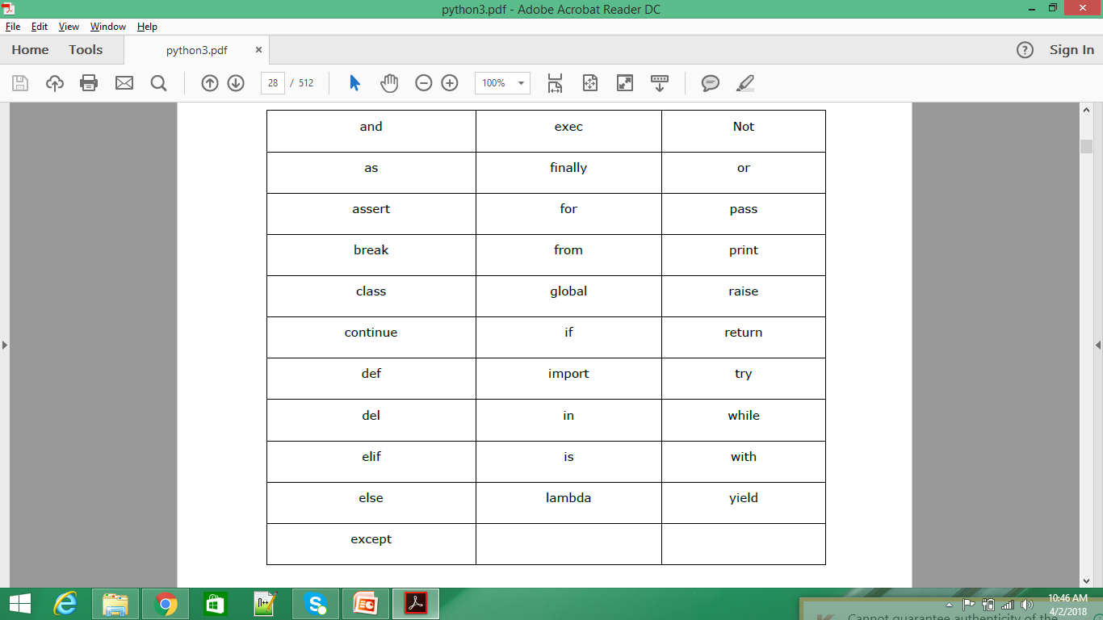
Reserved Words
The following list shows the Python keywords.
These are reserved words and you cannot use them as constants or variables or any other identifier names.
All the Python keywords contain lowercase letters only

Slide 16
Constants In Python
A constant is a type of variable whose value cannot be changed.
It is helpful to think of constants as containers that hold information which cannot be changed later.
You can think of constants as a bag to store some books which cannot be replaced once placed inside the bag.
Assigning value to constant in Python
In Python, constants are usually declared and assigned in a module.
Here, the module is a new file containing variables, functions, etc which is imported to the main file.
Inside the module, constants are written in all capital letters and underscores separating the words.
Note: In reality, we don't use constants in Python. Naming them in all capital letters is a convention to separate them from variables, however, it does not actually prevent reassignment.

Slide 17
Constants In Python
Declaring and assigning value to a constant
Create a constant.py:
PI = 3.14
GRAVITY = 9.8
Create a main.py:
import constant
print(constant.PI)
print(constant.GRAVITY)
Output
3.14
9.8
In the above program, we create a constant.py module file.
Then, we assign the constant value to PI and GRAVITY.
After that, we create a main.py file and import the constant module.
Finally, we print the constant value.

Slide 18
Lines and Indentation
Python does not use braces({}) to indicate blocks of code for class and function definitions or flow control.
Blocks of code are denoted by line indentation, which is rigidly enforced.
The number of spaces in the indentation is variable, but all statements within the block must be indented the same amount.
For example
if True:
print ("True")
else:
print ("False")
in Python all the continuous lines indented with the same number of spaces would form a block.

Slide 19
Waiting for the User Input
The following line of the program displays the prompt and the statement saying “Press the enter key to exit”, and then waits for the user to take action −
input(“ \n\n Press the enter key to exit.")
Multiple Statements on a Single Line
The semicolon ( ; ) allows multiple statements on a single line given that no statement starts a new code block.
Here is a sample snip using the semicolon
Import sys; x = 'foo'; sys.stdout.write(x + '\n')

Slide 20
Multi-Line Statements
Statements in Python typically end with a new line.
Python, however, allows the use of the line continuation character (\) to denote that the line should continue.
For example
Total = item_one + \
item_two + \
item_three
The statements contained within the [], {}, or () brackets do not need to use the line continuation character.
For example
Days = ['Monday', 'Tuesday', 'Wednesday',
'Thursday', 'Friday']

Slide 21
Built-in datatypes
Python has the following data types built-in by default, in these categories:
Text Type: | str
Numeric Types: | int, float, complex
Sequence Types: | list, tuple, range
Mapping Type: | dict
Set Types: | set, frozenset
Boolean Type: | bool
Binary Types: | bytes, bytearray, memoryview

Slide 22
Built-in datatypes
Variables can store data of different types, and different types can do different things.
NONE
The None keyword is used to define a null variable or an object.
None keyword is an object, and it is a data type of the class NoneType
None is used to define a null value. It is not the same as an empty string, False, or a zero.
Assigning a value of None to a variable is one way to reset it to its original, empty state.
# we will check the type of None
print(type(None))
Output
<class 'NoneType'>

Slide 23
Text datatypes
str Data type
In python, str represents string datatype.
A string is represented by a group of characters.
Strings are enclosed in single quotes or double quotes. Both are valid.
Python strings are immutable
Str = “welcome” # here str is name of string type variable
Str = ‘welcome’ # here str is name of string type variable
We can also write strings inside””” (triple double quotes) or ‘’’ (triple single quotes) to span a group of lines including spaces.
Str1 = “”” Here we discusses all the topics of python in a very lucid manner.”””
Str2 = ‘’’ Here we discusses all the topics of python in a very lucid manner.’’’
The triple double quotes or triple single quotes are useful to embed a string inside another string as show below:
str = """ This is 'core python ' book."""
print(str) #will display: This is 'core python' book

Slide 24
Text datatypes
To manipulate strings, we can use some of Pythons built-in methods.
Creation
word = "Hello World"
>>> print (word)
Hello World
Accessing
Use [ ] to access characters in a string
word = "Hello World"
letter=word[0]
>>> print (letter)
H
Length
word = "Hello World"
>>> len(word)
11
Finding
word = "Hello World"
>>> print (word.count('l')) # count how many times l is in the string
3
>>> print (word.find("H") ) # find the word H in the string
0
>>> print (word.index("World") ) # find the letters World in the string
6
Count
s = "Count, the number of spaces"
>>> print (s.count(' '))
8
Repeat Strings
>>>print ("."* 10) # prints ten dots
..........

Slide 25
Text datatypes
Slicing
Use [ # : # ] to get set of letter
Keep in mind that python, as many other languages, starts to count from 0!!
word = "Hello World"
print (word[0] ) #get one char of the word
print (word[0:1] ) #get one char of the word (same as above)
print (word[0:3] ) #get the first three char
print (word[:3] ) #get the first three char
print (word[-3:] ) #get the last three char
print (word[3:] ) #get all but the three first char
print (word[:-3] ) #get all but the three last character
word = "Hello World"
word[start:end] # items start through end-1
word[start:] # items start through the rest of the list
word[:end] # items from the beginning through end-1
word[:] # a copy of the whole list

Slide 26
Text datatypes
Split Strings
word = "Hello World"
>>> word.split(' ') # Split on whitespace
['Hello', 'World']
Startswith / Endswith
word = "hello world"
>>> word.startswith(“h")
True
>>> word.endswith("d")
True
>>> word.endswith("w")
False
Replacing
word = "Hello World"
>>> word.replace("Hello", "Goodbye")
'Goodbye World’
Changing Upper and Lower Case Strings
string = "Hello World"
>>> print (string.upper())
HELLO WORLD
>>> print (string.lower())
hello world
>>> print (string.title())
Hello World
>>> print (string.capitalize())
Hello world
>>> print (string.swapcase())
hELLO wORLD
Reversing
string = "Hello World"
>>> print (' '.join(reversed(string)) )
d l r o W o l l e H

Slide 27
Text datatypes
Strip
Python strings have the strip(), lstrip(), rstrip() methods for removing any character from both ends of a string.
If the characters to be removed are not specified then white-space will be removed
word = "Hello World"
Strip off newline characters from end of the string
>>> print (word.strip(''))
Hello World
strip() #removes from both ends
lstrip() #removes leading characters (Left-strip)
rstrip() #removes trailing characters (Right-strip)
>>> word = " xyz "
>>> print (word)
xyz
>>> print word.strip()
xyz
>>> print word.lstrip()
xyz
>>> print word.rstrip()
xyz

Slide 28
Text datatypes
Concatenation
To concatenate strings in Python use the "+" operator.
"Hello " + "World" # = "Hello World"
"Hello " + "World" + "!“ # = "Hello World!"
Join
>>> print (":".join(word) ) # add a : between every char
H:e:l:l:o: :W:o:r:l:d
>>> print (" ".join(word) ) # add a whitespace between every char
H e l l o W o r l d
The partition() method searches for a specified string, and splits the string into a tuple containing three elements.
The first element contains the part before the specified string.
The second element contains the specified string.
The third element contains the part after the string.
Note: This method search for the first occurrence of the specified string.
Search for the word "bananas", and return a tuple with three elements:
1 - everything before the "match" 2 - the "match" 3 - everything after the "match“
txt = "I could eat bananas all day" x = txt.partition("bananas") print(x)
('I could eat ', 'bananas', ' all day')

Slide 29
Text datatypes
Testing
A string in Python can be tested for truth value.
The return type will be in Boolean value (True or False)
word = "Hello World"
word.isalnum() #check if all char are alphanumeric
word.isalpha() #check if all char in the string are alphabetic
word.isdigit() #test if string contains digits
word.istitle() #test if string contains title words
word.isupper() #test if string contains upper case
word.islower() #test if string contains lower case
word.isspace() #test if string contains spaces
word.endswith('d') #test if string endswith a d
word.startswith('H') #test if string startswith H

Slide 30
NUMERIC AND BOOL DATA TYPE
Numeric Data Types
Integers
An integer is a whole number, negative, positive or zero.
type() function can be used to determine the data type of a variable.
>>> a = 5
>>> type(a)
<class 'int'>
Floating Point Numbers
Floating point numbers or floats
Floats are decimals, positive, negative and zero.
Floats can also be represented by numbers in scientific notation which contain exponents.
a float can be defined using a decimal point . when a variable is assigned.
>>> c = 6.2
>>> type(c)
<class 'float'>
>>> Na = 6.02e23
>>> Na
6.02e+23
>>>type(Na)
<class 'float‘>

Slide 31
NUMERIC AND BOOL DATA TYPE
Complex Numbers
A complex number is defined in Python using a real component + an imaginary component j.
The letter j must be used to denote the imaginary component.
Using the letter i to define a complex number returns an error in Python.
>>> comp = 4 + 2j
>>> type(comp)
<class 'complex'>
Imaginary numbers can be added to integers and floats.
>>>intgr = 3
>>> type(intgr)
<class 'int'>
>>>comp_sum = comp + intgr
>>> print(comp_sum)
(7+2j)
>>>flt = 2.1
>>>comp_sum = comp + flt
>>> print(comp_sum)
(6.1+2j)

Slide 32
NUMERIC AND BOOL DATA TYPE
Boolean data type
Python boolean type is one of the built-in data types provided by Python, which are defined by the True or False keywords.
Generally, it is used to represent the truth values of the expressions.
The output <class ‘bool’> indicates the variable is a boolean data type.
b =False
type(b)
Output:
<class 'bool'>
Generally, booleans values are returned as a result of some sort of comparison.

Slide 33
NUMERIC AND BOOL DATA TYPE
Boolean data type
Integers and Floats as Booleans
Numbers can be used as bool values by using Python’s built-in bool() method.
Any integer, floating-point number, or complex number having zero as a value is considered as False, while if they are having value as any positive or negative number then it is considered as True.
var1 =0
print(bool(var1))
var2 =1
print(bool(var2))
var3 =-9.7
print(bool(var3))
Output:
False
True
True

Slide 34
Sequences In Python
Generally, a sequence represents a group of elements or items.
For example, a group of integer numbers will form a sequence.
There are six types of sequences in python:
str
bytes
bytearray
list
tuple
range

Slide 35
List In Python
The simplest data structure in Python and is used to store a list of values.
Lists are collections of items (strings, integers, or even other lists).
Each item in the list has an assigned index value.
Lists are enclosed in [ ]
Each item in a list is separated by a comma
Unlike strings, lists are mutable, which means they can be changed.
lists in python are similar to arrays , list can store different types of elements and , lists can grow dynamically in memory
list = [10, -20 , 15.5, ‘vijay’, “mary” ]

Slide 36
List In Python
List Creation
Lists are created using a comma separated list of values surrounded by square brackets.
Lists hold a sequence of values (just like strings can hold a sequence of characters).
Lists are very easy to create, these are some of the ways to make lists
An empty list is created using just square brackets:
emptyList = [ ]
list1 = ['one’, ‘two’, ‘three’, ‘four’, ‘five']
numlist = [1, 3, 5, 7, 9]
mixlist = ['yellow', 'red', 'blue', 'green', 'black', 1, 10]
List Length
With the length function we can get the length of a list
list = ["1", "hello", 2, "world"]
len(list)
>>4
List Indexing
Each item in the list has an assigned index value starting from 0.
Accessing elements in a list is called indexing.
list = ["first", "second", "third"]
list[0] = "first"
list[1] = "second"
list[2] = "third“
List Slicing
Accessing parts of segments is called slicing.
Lists can be accessed just like strings by using the [ ] operators.
The key point to remember is that the :end value represents the first value that is not in the selected slice.
So, the difference between end and start is the number of elements selected
Default step is 1

Slide 37
List In Python
Let's create a list with some values in it
colors = ['yellow', 'red', 'blue', 'green', 'black']
print (colors[0])
>>> yellow
print colors [1:]
>>> red, blue, green, black
Let's look at this example taken from this stackoverflow post.
a[start:end] # items start through end-1
a[start:] # items start through the rest of the array
a[:end] # items from the beginning through “end-1”
a[:] # a copy of the whole array
There is also the step value, which can be used with any of the above
a[start: end: step] # start through not past end, by step
The other feature is that start or end may be a negative number, which means it counts from the end of the array instead of the beginning.
a[-1] # last item in the array
a[-2:] # last two items in the array
a[:-2] # everything except the last two items
List Split
Split each element in a list.
mylist = "one;two;three;four,five;1;2"
newlist = mylist.split(';')
print (newlist)
['one', 'two', 'three', 'four,five', '1', '2']

Slide 38
List In Python
List Append
List append will add the item at the end.
list = ["Movies", "Music", "Pictures"]
list.append(x) will add an element to the end of the list
list.append("Files")
print (list)
>> ['Movies', 'Music', 'Pictures', 'Files']
,List Insert
If you want to add at the beginning, you can use the insert function (see below)
list.insert(0, "Files")
The syntax is: list.insert(x, y) #will add element y on the place before x
list = ["Movies", "Music", "Pictures"]
list.insert(2,"Documents")
print list
['Movies', 'Music', 'Documents', 'Pictures', 'Files']
List Remove
To remove an element's first occurrence in a list, simply use list.remove()
The syntax is: list.remove(x)
List = ['Movies', 'Music', 'Files', 'Documents', 'Pictures']
list.remove("Files")
print (list)
>>['Movies', 'Music', 'Documents', 'Pictures']
List Delete
Use del to remove item based on index position.
list = ["Matthew", "Mark", "Luke", "John"]
del list[1]
print list
>>>Matthew, Luke, John

Slide 39
List In Python
List Extend
The syntax is: list.extend(x) #will join the list with list x
list2 = ["Music2", "Movies2"]
list1.extend(list2)
print list1
>>['Movies', 'Music', 'Documents', 'Pictures', 'Music2‘,'Movies2']
NOTE: A list is an object. If you append another list onto a list, the second list will be a single object at the end of the list.
my_list = ['geeks', 'for', 'geeks']
another_list = [6, 0, 4, 1]
my_list.append(another_list)
print my_list
['geeks', 'for', 'geeks', [6, 0, 4, 1]]
NOTE: A string is an iterable, so if you extend a list with a string, you’ll append each character as you iterate over the string.
my_list = ['geeks', 'for', 6, 0, 4, 1]
my_list.extend('geeks')
print my_list
['geeks', 'for', 6, 0, 4, 1, 'g', 'e', 'e', 'k', 's']
List Keywords
The keyword "in" can be used to test if an item is in a list.
list = ["red", "orange", "green", "blue"]
if "red" in list:
do_something()
#Keyword "not" can be combined with "in".
list = ["red", "orange", "green", "blue"]
if "purple" not in list:
do_something()

Slide 40
List In Python
List Reverse
The reverse method reverses the order of the entire list.
L1 = ["One", "two", "three", "four", "five"]
#To print the list as it is, simply do:
print (L1)
#To print a reverse list, do:
for i in L1[::-1]:
print (i)
#OR
L = [0, 10, 20, 40]
L.reverse()
print (L)
[40, 20, 10, 0]

Slide 41
List In Python
List Sorting
The easiest way to sort a List is with the sorted(list) function.
That takes a list and returns a new list with those elements in sorted order.
The original list is not changed.
The sorted() function can be customized though optional arguments.
The sorted() optional argument reverse=True, e.g. sorted(list, reverse=True), makes it sort backwards.
#create a list with some numbers in it
numbers = [5, 1, 4, 3, 2, 6, 7, 9]
#prints the numbers sorted
print (sorted(numbers) )
#the original list of numbers are not changed
print (numbers)
This will not return a value, it will modify the list
list.sort()
my_string = ['aa', 'BB', 'zz', 'CC', 'dd', "EE"]
#if no argument is used, it will use the default (case sensitive)
print (sorted(my_string))
#using the reverse argument, will print the list reversed
print (sorted(strs, reverse=True)) ## ['zz', 'aa', 'CC', 'BB']

Slide 42
List In Python
List pop
The pop() method removes the specified index, (or the last item if index is not specified):
thislist = ["apple", "banana", "cherry"] thislist.pop() print(thislist)
List Clear
The clear() method empties the list:
thislist = ["apple", "banana", "cherry"] thislist.clear() print(thislist)
List count
The count() method returns the number of elements with the specified value.
points = [1, 4, 2, 9, 7, 8, 9, 3, 1] x = points.count(9)
List copy
The copy() method returns a copy of the specified list.
fruits = ['apple', 'banana', 'cherry', 'orange'] x = fruits.copy()
print(x)
List constructor
Using the list() constructor to make a List:
thislist = list(("apple", "banana", "cherry")) # note the double round-brackets print(thislist)

Slide 43
List In Python
List Methods
Calls to list methods have the list they operate on appear before the method name.
Any other values the method needs to do its job is provided in the normal way as an extra argument inside the round brackets.
s = ['h','e','l','l','o'] #create a list
s.append('d') #append to end of list
s.sort() #sorting the list
list.index(obj) #Returns the lowest index in list that obj appears
s.reverse() #reversing the list
s.extend(['w','o']) #grow list
s.insert(1,2) #insert into list
s.remove('d') #remove first item in list with value d
s.pop() #remove last item in the list

Slide 44
List In Python
s.pop(1) #remove indexed value from list
s.count('o') #search list and return number of inst ances found
s = range(0,10) #create a list over range
s = range(0,10,2) #same as above, with start index and increment
List Functions
cmp(list1, list2) Compares elements of both lists.
max(list) Returns item from the list with max value.
min(list) Returns item from the list with min value.
list(seq) Converts a tuple into list.

Slide 45
List In Python
List Loops
#If you already have items in a list, you can easily loop through them like this:
items = [ 1, 2, 3, 4, 5 ]
for i in items:
print (i)
Example : First, create a list containing only numbers.
list = [1,2,3,5,8,2,5.2] #creates a list containing the values 1,2,3,5,8,2,5.2
i = 0
while i < len(list): #The while loop will print each element in the list
print list[i] #Each element is reached by the index (the letter in the square bracket)
i = i + 1 #Increase the variable i with 1 for every time the while loop runs.
Notes:
The next example will count the average value of the elements in the list.
list = [1,2,3,5,8,2,5.2]
total = 0
i = 0
while i < len(list):
total = total + list[i]
i = i + 1
average = total / len(list)
print average

Slide 46
List In Python
List Comprehensions
List comprehensions provide a concise way to create lists.
It consists of brackets containing an expression followed by a for clause, then zero or more for or if clauses.
The expressions can be anything, meaning you can put in all kinds of objects in lists.
The result will be a new list resulting from evaluating the expression in the context of the for and if clauses which follow it.
The list comprehension always returns a result list.
The basic syntax is
[ expression for item in list if conditional ]
This is equivalent to:
for item in list:
if conditional:
expression
Which corresponds to:
*result* = [*transform* *iteration* *filter* ]

Slide 47
List In Python
List Comprehensions
Let's start easy by creating a simple list.
x = [i for i in range(10)]
print x
# This will give the output:
[0, 1, 2, 3, 4, 5, 6, 7, 8, 9]
If you used to do it like this:
new_list = []
for i in old_list:
if filter(i):
new_list.append(expressions(i))
You can obtain the same thing using list comprehension:
new_list = [expression(i) for i in old_list if filter(i)]

Slide 48
List In Python
Sample problems
Sort the given list of elements using bubble sort
Find the largest and smallest element from the list
Print the even no’s using list Comprehensions
Delete elements whose indexed is multiple of 3 from a given list of 20 elements
Notes:
Write a Python program to sum all the items in a list.
def sum_list(items):
sum_numbers = 0
for x in items:
sum_numbers += x
return sum_numbers
print(sum_list([1,2,-8]))
Find the largest element from the list
def max_num_in_list( list ):
max = list[ 0 ]
for a in list:
if a > max:
max = a
return max
print(max_num_in_list([1, 2, -8, 0]))
Write a Python program to get a list, sorted in increasing order by the last element in each tuple from a given list of non-empty tuples.
def last(n): return n[-1]
def sort_list_last(tuples):
return sorted(tuples, key=last)
print(sort_list_last([(2, 5), (1, 2), (4, 4), (2, 3), (2, 1)]))
Write a Python program to remove duplicates from a list.
a = [10,20,30,20,10,50,60,40,80,50,40]
dup_items = set()
uniq_items = []
for x in a:
if x not in dup_items:
uniq_items.append(x)
dup_items.add(x)
print(dup_items)
Write a Python program to print the numbers of a specified list after removing even numbers from it.
num = [7,8, 120, 25, 44, 20, 27]
num = [x for x in num if x%2!=0]
print(num)
https://www.w3resource.com/python-exercises/list/

Slide 49
bytes Data type
The byte datatype represents a group of byte numbers just like an array does.
A byte number is any position integer from 0 to 255(inclusive).
byte array can store numbers in the range from 0 to 255 and it cannot store negative numbers.
elements = [10,20,0,40,15] #this is a list of byte numbers
x = bytes(elements) # convert the list into bytes array
print(x[0]) #display 0th element, i.e 10
We cannot modify or edit any element in the bytes type array.
For example, x[0] = 55 gives an error.
Here we are trying to replace 0th element (i.e 10) by 55 which is not allowed.
A python program to create a byte type array, read
and display the elements of the array:
#program to understand bytes type array
#create a list of byte numbers
elements = [10,20,0,40,15]
#convert the list into bytes type array
x = bytes(elements)
# retrieve elements from x using for loop and display
for i in x:
print(i)
output:
c:\>python bytes.py
10
20
0
40
15

Slide 50
Byte array Data type
The bytearray datatype is similar to byte datatype.
The difference is that the byte type array cannot be modified but the bytearray type array can be modified.
It means an element or all the elements of the bytearray type can be modified.
To create a bytearray type array, we can use the function bytearray.
elements = [10,20,0,40,15] #this is a list of byte numbers
x = bytearrays(elements) #convert the list into bytearray type array
print(x[0]) #display 0th element, i.e 10
We can modify or edit the elements of the bytearray .
x[0] = 88 #replace 0th element by 88
x[1] = 99 #replace 1st element by 99

Slide 51
Byte array Data type
A python program to create a bytearray type array and retrieve elements
#program to understand bytearray type array
#create a list of byte numbers
elements = [10,20,0,40,15]
#convert the list into bytearray type array
x = bytearray(elements)
#modify the first two elements of x
x[0] = 88
x[1] = 99
#retrieve elements from x using for loop and display
for i in x:
print(i)
Output:
c:\python bytearray.py
88
99
0
40
15

Slide 52
Tuple Data type
A tuple is a collection which is ordered and unchangeable.
In Python tuples are written with round brackets ( ).
A tuple is similar to a list.
A tuple contains a group of elements which can be of different types.
The elements in the tuple are separated by commas and enclosed in parenthesis ().
Whereas the list elements can be modified, it is not possible o modify the tuple elements.
That means a tuple can be treated as a read-only list.
thistuple = ("apple", "banana", "cherry") print(thistuple)
A tuple is a collection of objects which ordered and immutable

Slide 53
Tuple Data type
tpl = (10, -20, 15.5, ‘vijay’ , “mary”)
The individual elements of the tuple can be referenced using square braces as tpl[0], tpl[1], tpl[2],…
Now, if we try to modify the 0th element as:
tpl[0] = 99
This will result in error.
Access Tuple Items
You can access tuple items by referring to the index number, inside square brackets:
thistuple = ("apple", "banana", "cherry")
print(thistuple[1])
tup1 = ('physics', 'chemistry', 1997, 2000)
tup2 = (1, 2, 3, 4, 5, 6, 7 )
print ("tup1[0]: ", tup1[0])
print ("tup2[1:5]: ", tup2[1:5])

Slide 54
Tuple Data type
tup1 = (12, 34.56);
tup2 = ('abc', 'xyz');
# So let's create a new tuple as follows
tup3 = tup1 + tup2;
print tup3;
Loop Through a Tuple
You can loop through the tuple items by using a for loop.
thistuple = ("apple", "banana", "cherry") for x in thistuple: print(x)
Check if Item Exists
To determine if a specified item is present in a tuple use the in keyword:
thistuple = ("apple", "banana", "cherry") if "apple" in thistuple: print("Yes, 'apple' is in the fruits tuple")
Tuple Length
To determine how many items a tuple has, use the len() method:
thistuple = ("apple", "banana", "cherry") print(len(thistuple))

Slide 55
Tuple Data type
Add Items
Once a tuple is created, you cannot add items to it. Tuples are unchangeable.
thistuple = ("apple", "banana", "cherry") thistuple[3] = "orange" # This will raise an error print(thistuple)
Remove Items
Tuples are unchangeable, so you cannot remove items from it, but you can delete the tuple completely:
thistuple = ("apple", "banana", "cherry") del thistuple print(thistuple) #this will raise an error because the tuple no longer exists
cmp(tuple1, tuple2)
Compares elements of both tuples.
tuple1, tuple2 = (123, 'xyz'), (456, 'abc')
print( cmp(tuple2, tuple1) o/p 1
max(tuple) and min(tuple)
Returns item from the tuple with max value.
tuple1= (123, 'xyz', 'zara', 'abc’)
print ("Max value element : ", max(tuple1))
print ("min value element : ", min(tuple1))
tuple(seq)
Converts a list into tuple.
aList = [123, 'xyz', 'zara', 'abc']
aTuple = tuple(aList)
Print( "Tuple elements : ", aTuple)

Slide 56
Tuple Data type
The tuple() Constructor
It is also possible to use the tuple() constructor to make a tuple.
thistuple = tuple(("apple", "banana", "cherry")) # note the double round-brackets print(thistuple)
Indexing, Slicing, and Matrixes
Because tuples are sequences, indexing and slicing work the same way for tuples as they do for strings.
Assuming following input −
L = ('spam', 'Spam', 'SPAM!')
L[2] 'SPAM!' Offsets start at zero
L[-2] 'Spam' Negative: count from the right
L[1:] ['Spam', 'SPAM!'] Slicing fetches sections

Slide 57
Dictionary Data type
A dictionary is a collection which is unordered, changeable and indexed.
In Python dictionaries are written with curly brackets, and they have keys and values.
thisdict = { "brand": "Ford", "model": "Mustang", "year": 1964 } print(thisdict)
Dictionaries are Python's implementation of a data structure that is more generally known as an associative array.
A dictionary consists of a collection of key-value pairs.
Each key-value pair maps the key to its associated value.
An empty dictionary without any items is written with just two curly braces, like this: {}.
Keys are unique within a dictionary while values may not be. The values of a dictionary can be of any type, but the keys must be of an immutable data type such as strings, numbers, or tuples.

Slide 58
Dictionary Data type
Accessing Items
You can access the items of a dictionary by referring to its key name, inside square brackets:
x = thisdict["model"]
There is also a method called get() that will give you the same result:
x = thisdict.get("model")
Change Values
You can change the value of a specific item by referring to its key name:
thisdict = { "brand": "Ford", "model": "Mustang", "year": 1964 } thisdict["year"] = 2018
Dictionary Length
To determine how many items (key-value pairs) a dictionary has, use the len() method.
Print the number of items in the dictionary:
print(len(thisdict))
Adding Items
Adding an item to the dictionary is done by using a new
index key and assigning a value to it:
thisdict = { "brand": "Ford", "model": "Mustang", "year": 1964 } thisdict["color"] = "red" print(thisdict)

Slide 59
Dictionary Data type
Loop Through a Dictionary
You can loop through a dictionary by using a for loop.
When looping through a dictionary, the return value are the keys of the dictionary, but there are methods to return the values as well.
Print all key names in the dictionary, one by one:
for x in thisdict: print(x)
Print all values in the dictionary, one by one:
for x in thisdict: print(thisdict[x])
You can also use the values() function to return values of a dictionary:
for x in thisdict.values(): print(x)
Loop through both keys and values, by using the items() function:
for x, y in thisdict.items(): print(x, y)
Check if Key Exists
To determine if a specified key is present in a dictionary use the in keyword:
thisdict = { "brand": "Ford", "model": "Mustang", "year": 1964 } if "model" in thisdict: print("Yes, 'model' is one of the keys in the thisdict dictionary“)

Slide 60
Dictionary Data type
Removing Items
There are several methods to remove items from a dictionary:
The pop() method removes the item with the specified key name:
thisdict = { "brand": "Ford“, "model": "Mustang", "year": 1964 } thisdict.pop("model") print(thisdict)
The popitem() method removes the last inserted item (in versions before 3.7, a random item is removed instead):
thisdict.popitem() print(thisdict)
The del keyword removes the item with the specified key name:
del thisdict["model"] print(thisdict)
The del keyword can also delete the dictionary completely:
del thisdict print(thisdict)
#this will cause an error because "thisdict“ no longer exists.
The clear() keyword empties the dictionary:
thisdict.clear() print(thisdict)

Slide 61
Dictionary Data type
The dict() Constructor
It is also possible to use the dict() constructor to make a dictionary:
thisdict = dict(brand="Ford", model="Mustang", year=1964) # note that keywords are not string literals # note the use of equals rather than colon for the assignment print(thisdict)
Dictionary Methods
clear() : Removes all the elements from the dictionary
thisdict.clear()
copy() : Returns a copy of the dictionary
dict1 = {'Name': 'Zara', 'Age': 7};
dict2 = dict1.copy()
fromkeys() Returns a dictionary with the specified keys and values
seq = ('name', 'age', 'sex')
thisdict = dict.fromkeys(seq)
print ("New Dictionary : %s" % str(dict))
dict2 = dict.fromkeys(seq, 10)
print ("New Dictionary : %s" % str(dict))
New Dictionary : {'age': None, 'name': None, 'sex': None}
New Dictionary : {'age': 10, 'name': 10, 'sex': 10}
get() : Returns the value of the specified key
dict.get('Age')
items() : Returns a list containing the a tuple for each key value pair
dict = {'Name': 'Zara', 'Age': 7}
print "Value : %s" % dict.items()
Value : [('Age', 7), ('Name', 'Zara')]

Slide 62
Dictionary Data type
keys() : Returns a list containing the dictionary's keys
dict = {'Name': 'Zara', 'Age': 7}
print ("Value : %s" % dict.keys() )
Value : ['Age', 'Name']
pop() : Removes the element with the specified key
popitem() : Removes the last inserted key-value pair
setdefault() : Returns the value of the specified key. If the key does not exist: insert the key, with the specified value
dict = {'Name': 'Zara', 'Age': 7}
print ("Value : %s" % dict.setdefault('Age', None) )
print ("Value : %s" % dict.setdefault('Sex', None))
Value : 7
Value : None
update() : Updates the dictionary with the specified key-value pairs
dict = {'Name': 'Zara', 'Age': 7}
dict2 = {'Sex': 'female' }
dict.update(dict2)
print ("Value : %s" % dict )
Value : {'Age': 7, 'Name': 'Zara', 'Sex': 'female'}
values() : Returns a list of all the values in the dictionary
dict = {'Name': 'Zara', 'Age': 7}
print ("Value : %s" % dict.values())
Value : [7, 'Zara']

Slide 63
Dictionary Data type
Combining List and Dictionary
Example of a list of dictionaries
customers = [{"uid":1,"name":"John"},
{"uid":2,"name":"Smith"},
{"uid":3,"name":"Andersson"},
]
print (customers)
Output:
[{'uid': 1, 'name': 'John'}, {'uid': 2, 'name': 'Smith'},{'uid': 3, 'name‘: ‘Andersson'}]
customers[2]["name"]="charlie"
print customers
Output:
[{'uid': 1, 'name': 'John'}, {'uid': 2, 'name': 'Smith'}, {'uid': 3, 'name‘:'charlie'}]
Add a new field to each entry
for x in customers:
x["password"]="123456" # any initial value
print customers
Output:
[{'password': '123456', 'uid': 1, 'name': 'John'}, {'password': '123456', 'uid‘: 2, 'name': 'Smith'}, {'password': '123456', 'uid': 3, 'name': 'Andersson'}]
Notes:
Write a Python program to concatenate following dictionaries to create a new one.
dic1={1:10, 2:20}
dic2={3:30, 4:40}
dic3={5:50,6:60}
dic4 = {}
for d in (dic1, dic2, dic3): dic4.update(d)
print(dic4)
{1: 10, 2: 20, 3: 30, 4: 40, 5: 50, 6: 60}
Write a Python program to check if a given key already exists in a dictionary.
d = {1: 10, 2: 20, 3: 30, 4: 40, 5: 50, 6: 60}
def is_key_present(x):
if x in d:
print('Key is present in the dictionary')
else:
print('Key is not present in the dictionary')
is_key_present(5)
is_key_present(9)
Key is present in the dictionary Key is not present in the dictionary
Write a Python script to print a dictionary where the keys are numbers between 1 and 15 (both included) and the values are square of keys.
d=dict()
for x in range(1,16):
d[x]=x**2
print(d)
{1: 1, 2: 4, 3: 9, 4: 16, 5: 25, 6: 36, 7: 49, 8: 64, 9: 81, 10: 100, 11: 121, 12: 144, 13: 169, 14: 196, 15: 225}

Slide 64
set Data type
A set object is an unordered collection of distinct hashable objects.
It is commonly used in membership testing, removing duplicates from a sequence, and computing mathematical operations such as intersection, union, difference, and symmetric difference.
Sets support x in the set, len(set), and for x in set like other collections.
Set is an unordered collection and does not record element position or order of insertion.
Sets do not support indexing, slicing, or other sequence-like behavior.
There are currently two built-in set types, set, and frozenset.
The set type is mutable - the contents can be changed using methods like add() and remove().
Since it is mutable, it has no hash value and cannot be used as either a dictionary key or as an element of another set.
The frozenset type is immutable and hashable - its contents cannot be altered after it is created; it can, therefore, be used as a dictionary key or as an element of another set.

Slide 65
set Data type
Create a set in Python:
setx = set()
print(setx)
set()
#A non empty set
n = set([0, 1, 2, 3, 4, 5])
print(n)
{0, 1, 2, 3, 4, 5}
Add member(s) in Python set:
color_set = set()
color_set.add("Red") #Add a single member
print(color_set)
{'Red'}
#Add multiple items
color_set.update(["Blue", "Green"])
print(color_set)
{'Red', 'Blue', 'Green'}
Iteration Over Sets:
We can move over each of the items in a set using a loop. However, since sets are unordered, it is undefined which order the iteration will follow.
num_set = set([0, 1, 2, 3, 4, 5])
for n in num_set:
print(n)
Get the Length of a Set
To determine how many items a set has, use the len() method.
thisset = {"apple", "banana", "cherry"} print(len(thisset))

Slide 66
set Data type
Remove item(s) from Python set:
pop(), remove() and discard() functions are used to remove individual item from a Python set.
See the following examples :
You can also use the pop(), method to remove an item, but this method will remove the last item. Remember that sets are unordered, so you will not know what item that gets removed.
num_set = set([0, 1, 2, 3, 4, 5])
num_set.pop()
print(num_set)
Remove "banana" by using the remove() method:
thisset = {"apple", "banana", "cherry"} thisset.remove("banana") print(thisset)
Note: If the item to remove does not exist,, discard() will NOT raise an error.
The clear() method empties the set:
thisset = {"apple", "banana", "cherry"} thisset.clear() print(thisset)
The del keyword will delete the set completely:
thisset = {"apple", "banana", "cherry"} del thisset print(thisset)

Slide 67
set Data type
The set() Constructor
It is also possible to use the set() constructor to make a set.
Example
Using the set() constructor to make a set:
thisset = set(("apple", "banana", "cherry"))
# note the double round-brackets print(thisset)
difference() Method
Return a set that contains the items that only exist in set x, and not in set y:
x = {"apple", "banana", "cherry"} y = {"google", "microsoft", "apple"} z = x.difference(y) print(z)
The difference_update() method is different from the difference() method, because the difference() method returns a new set, without the unwanted items, and
the difference_update() method removes the unwanted items from the original set.
Remove the items that exist in both sets:
x = {"apple", "banana", "cherry"} y = {"google", "microsoft", "apple"} x.difference_update(y) print(x)

Slide 68
set Data type
intersection() Method
Return a set that contains the items that exist in both set x, and set y:
x = {"apple", "banana", "cherry"} y = {"google", "microsoft", "apple"} z = x.intersection(y) print(z)
Compare 3 sets, and return a set with items that is present in all 3 sets:
x = {"a", "b", "c"} y = {"c", "d", "e"} z = {"f", "g", "c"} result = x.intersection(y, z) print(result)
intersection_update() method removes the unwanted items from the original set.
isdisjoint() Method
Return True if no items in set x is present in set y:
x = {"apple", "banana", "cherry"} y = {"google", "microsoft", "facebook"} z = x.isdisjoint(y) print(z)
issubset() Method
Return True if all items set x are present in set y:
x = {"a", "b", "c"} y = {"f", "e", "d", "c", "b", "a"} z = x.issubset(y) print(z)
issuperset() Method
Return True if all items set y are present in set x:
x = {"f", "e", "d", "c", "b", "a"} y = {"a", "b", "c"} z = x.issuperset(y) print(z)

Slide 69
set Data type
symmetric_difference() Method
Return a set that contains all items from both sets, except items that are present in both sets:
x = {"apple", "banana", "cherry"} y = {"google", "microsoft", "apple"} z = x.symmetric_difference(y) print(z)
The symmetric_difference_update() method updates the original set by removing items that are present in both sets, and inserting the other items.
x.symmetric_difference_update(y)
update() Method
Insert the items from set y into set x:
x = {"apple", "banana", "cherry"} y = {"google", "microsoft", "apple"} x.update(y) print(x)
union() Method
Return a set that contains all items from both sets, duplicates are excluded:
x = {"apple", "banana", "cherry"} y = {"google", "microsoft", "apple"} z = x.union(y) print(z)
Unify more than 2 sets:
x = {"a", "b", "c"} y = {"f", "d", "a"} z = {"c", "d", "e"} result = x.union(y, z) print(result)
Notes:
Write a Python program to find maximum and the minimum value in a set.
#Create a set
seta = set([5, 10, 3, 15, 2, 20])
#Find maximum value
print(max(seta))
#Find minimum value
print(min(seta))
Write a Python program to find the length of a set.
#Create a set
seta = set([5, 10, 3, 15, 2, 20])
#Find the length use len()
print(len(seta))

Slide 70

www.mallareddyuniversity.ac.in
Notes:
You can safely remove this slide. This slide design was provided by SlideModel.com – You can download more templates, shapes and elements for PowerPoint from http://slidemodel.com

